Slide 1
Detecting breast cancer with convolutional neural networks
Erick Cobos Tandazo
April 2016
Notes:
Saludar, nombre, maestria en sistemas inteligentes
Goal: Dar a conocer en lo que hemos trabajado en el grupo de investigación en aplicar redes convolucionales a la detección de cancer de mama e interesarlos en cancer de mamá, Deep Learning.

Slide 2
Why breast cancer?
Breast cancer is the most commonly diagnosed cancer among women.
For women, death rates are the second highest of any cancer.
Survival rate when detected early is close to 100%
Notes:
Cancer es un término que se usa para describir varias enfermedades distintas donde celulas anomalas se dividen sin control produciendo tuimores y eventualmente invadiendo tejido cercano. Breast cancer es cuando se genera en tejidos del seno.
Besides skin cancer, breast cancer is one of the most commonly diagnosed cancer among American women. Just under 30% of cancers in women are breast cancers.
About 1 in 8 U.S., UK women will develop invasive breast cancer.
Death rates higher than those for any other cancer, besides lung cancer.

Slide 3
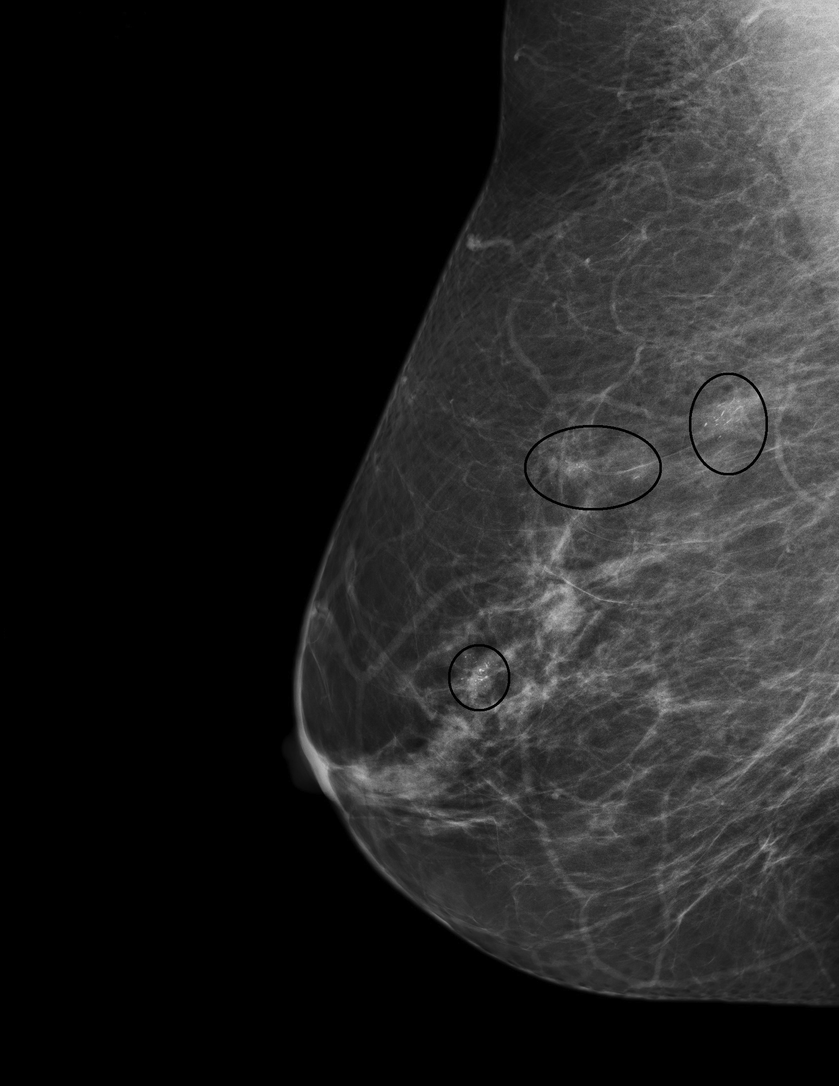
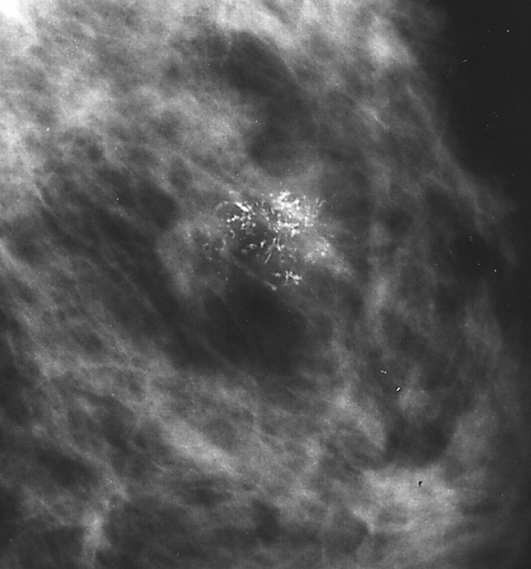
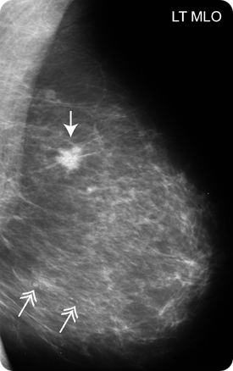
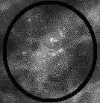
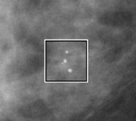
Breast cancer signs
Notes:
Mammography is the main tool to detect early breast cancer. Radiologists read them looking for microcalcifications and masses.
We focus on detecting and segmenting masses.

Slide 4
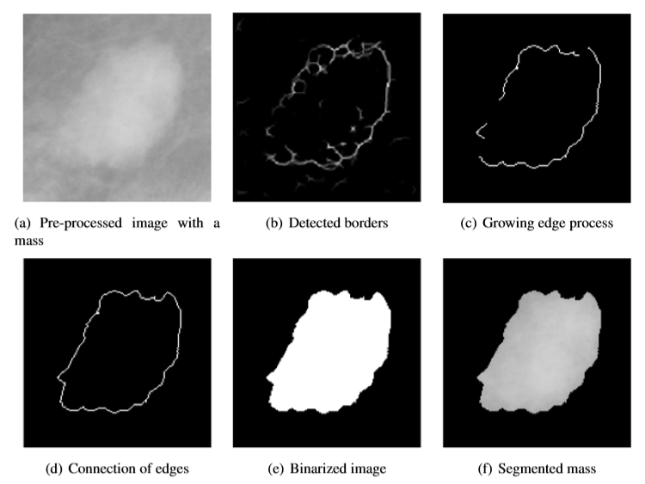
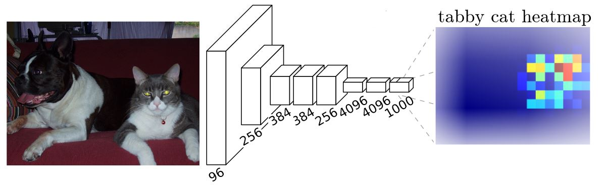
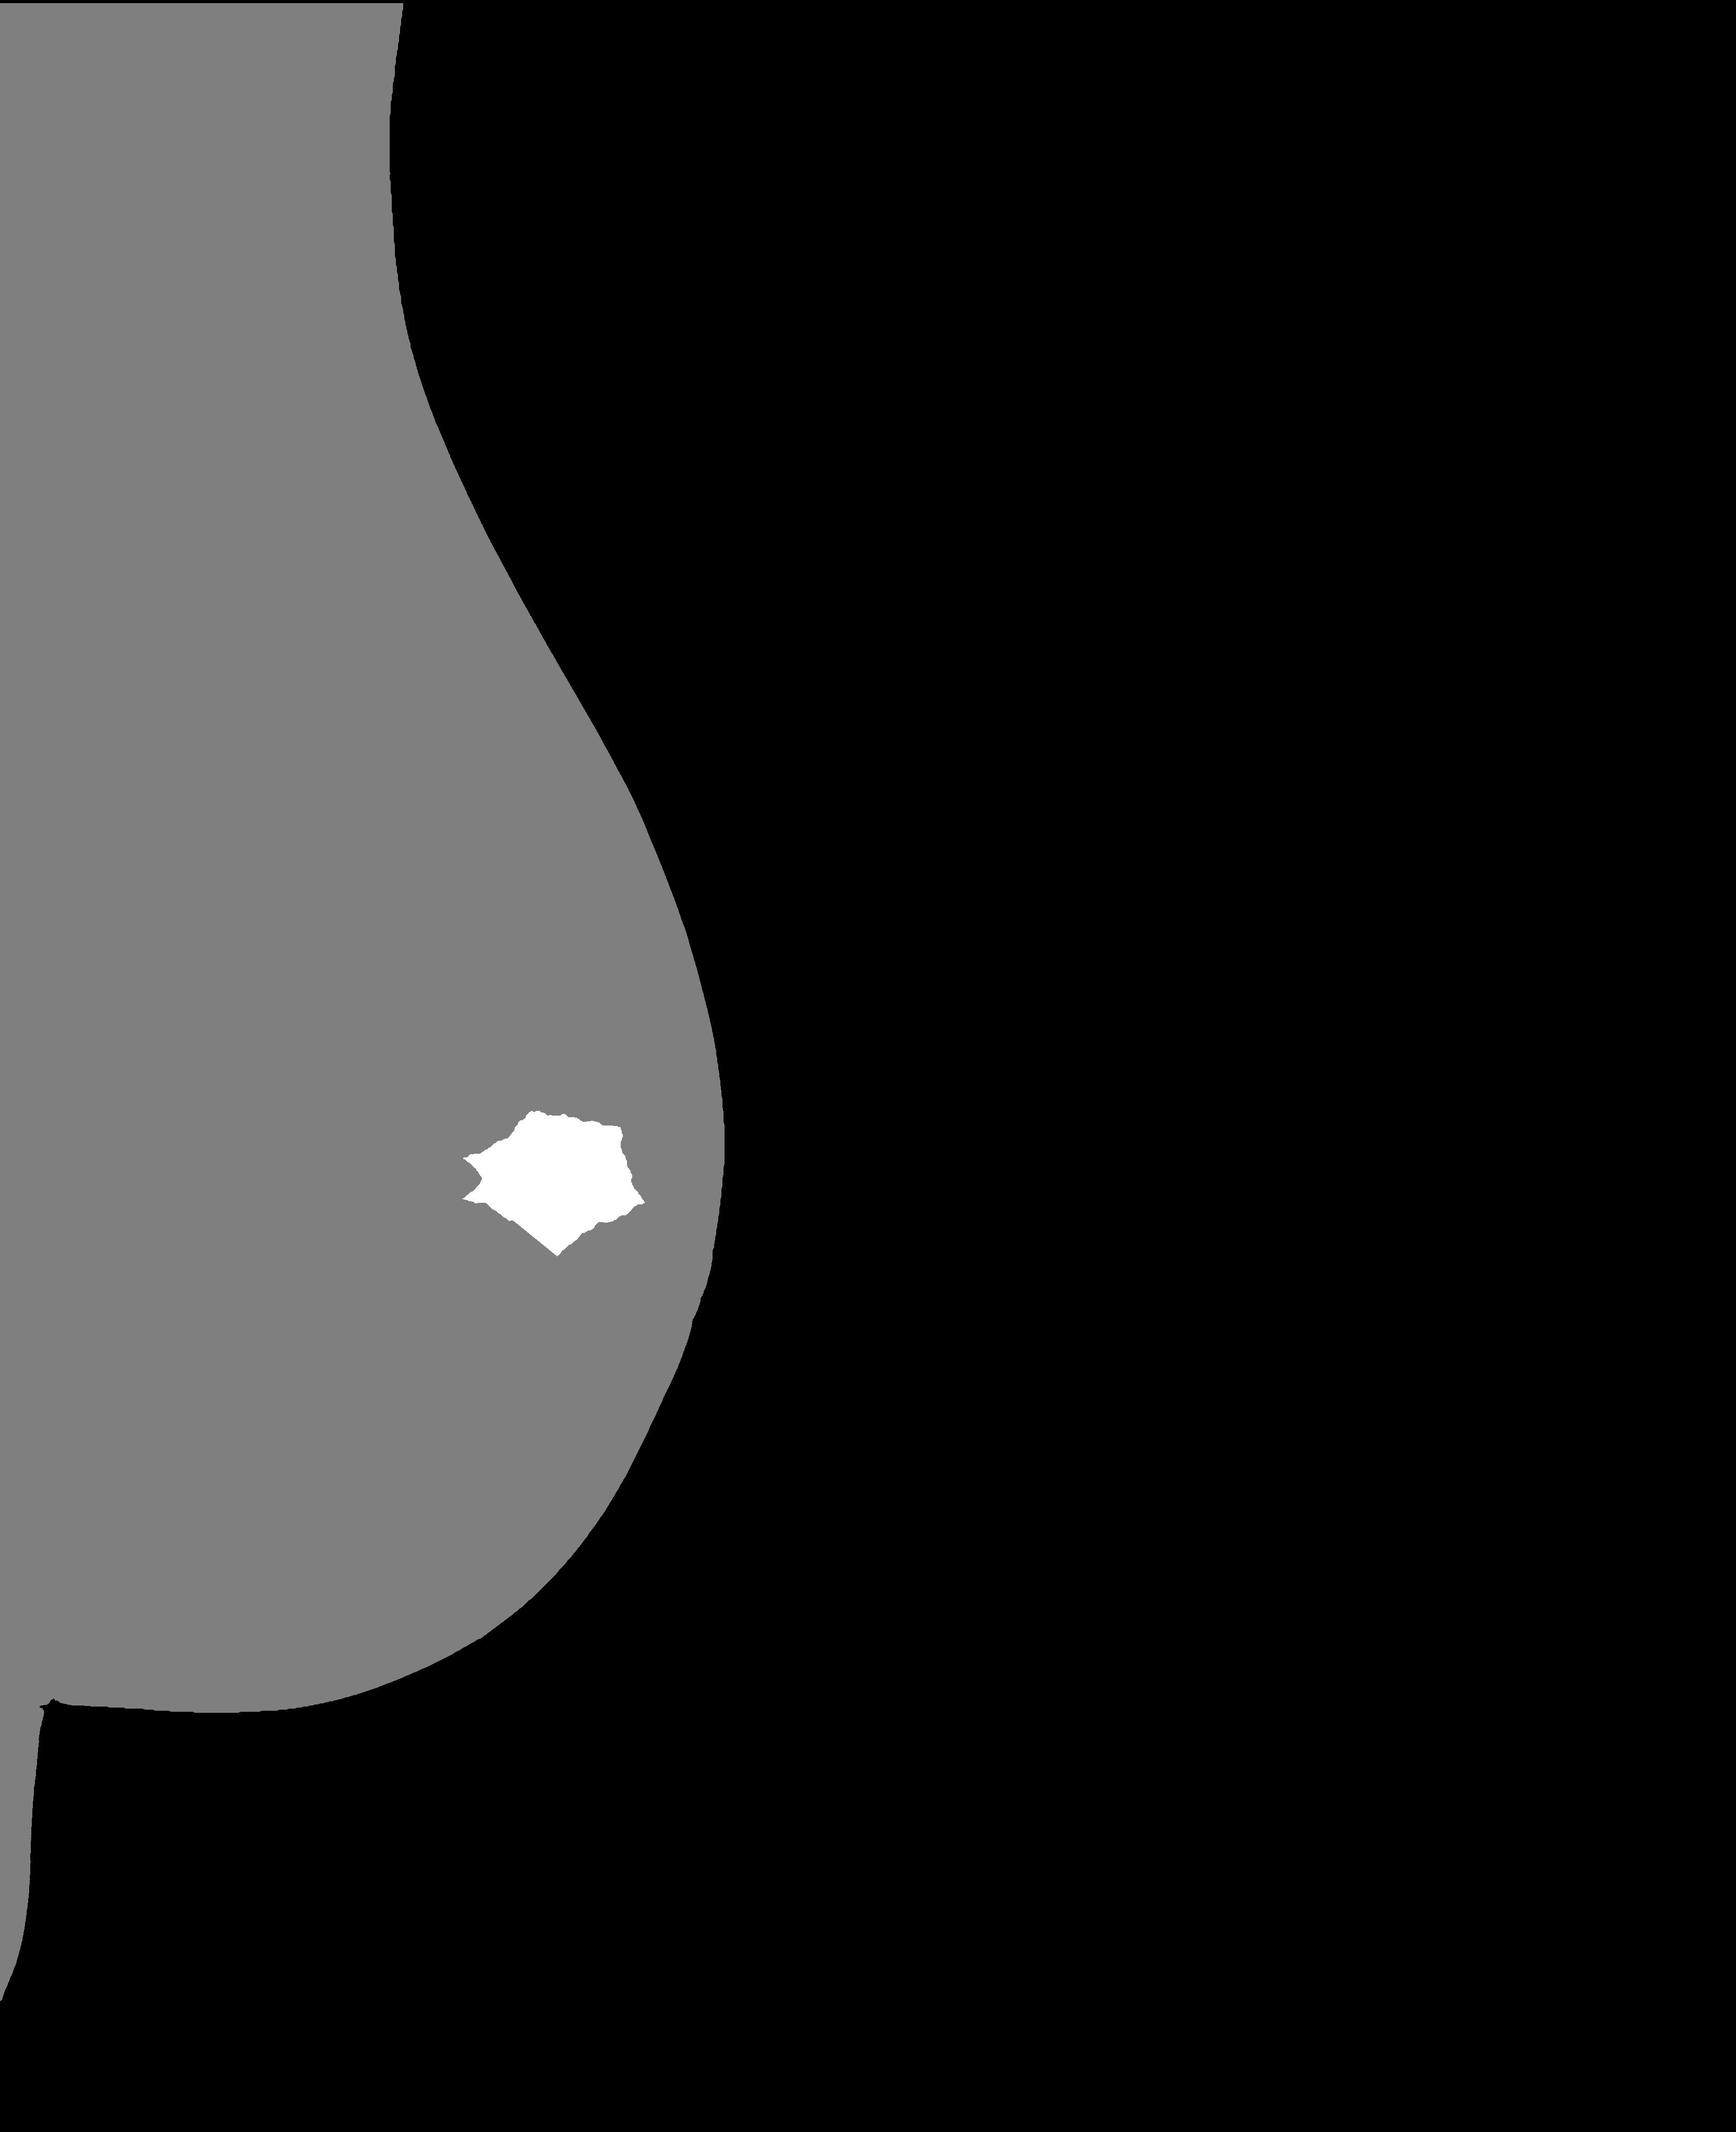
How do we detect them?
Notes:
Traditional way. Image visión, specialized techniques. Handcrafted features made by experts
But it is hard to design this, and it takes time to maintain, and you need expertise: end-to-end, learn from data, not done by hand

Slide 5
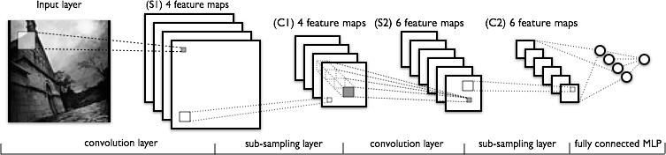

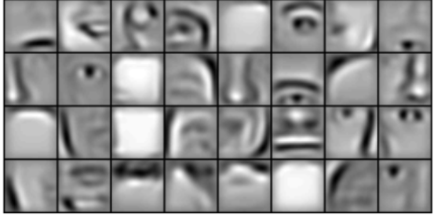
Convolutional networks
Notes:
We want to automatically segment mammograms. Hard to do by hand so we use machine learning which makes the computer learn it from data, end-to-end , specifically convolutional neural networks.
Not talk abouts specific: Convnets leanr filters.
Point similarity with visual cortex.

Slide 6
Why convolutional networks?
Convnets have showed great results in image classification tasks.
Convnets learn which features are important for the classification.
We don’t need experts to carefully handcraft and select features.
Cons: Needs processing power, data.
Notes:
From 2012 to now they have been used everywhere become standard in image processing, if there is a breakthrough in computer vision, most probably is donde with convnets.
ImageNet (super-human ability) They can be used as is for image segmentation.

Slide 7

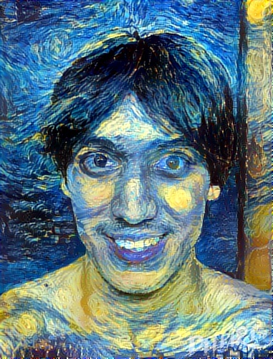
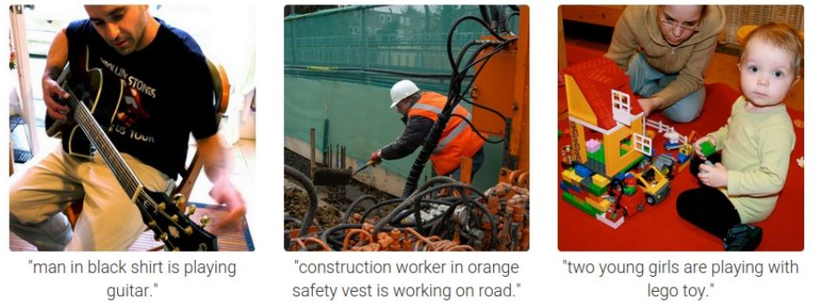
Some uses
Notes:
AlphaGo, Google Photo Search, Facebook Tagging, automated captioning, Galaxy classification, Deep Dream, deep Art (einstein in van gogh, microsoft how old are you).
Se puede hacer aqu[i

Slide 8
Our work
Literature Review
Obtain and preprocess data set
Design, implement and test a network
Prepare equipment
[In progress] Training the networks

Slide 9
Collaboration
Apply Machine Learning to your problems
Solve problems in Machine Learning
Explore new ideas
Notes:
Aplicarlo a imagenes de fmri, o aplicarlo en buscra una forma de representaci [on comun.
En esto voy atrabajar una vez quetermine este proyecto y probablemente en el doctorado (aunque aun no decido).

Slide 10

Thanks!

